Slide 1


Fundamentals of Music Processing
Chapter 7: Content-Based Audio Retrieval
Meinard Müller
International Audio Laboratories Erlangen
www.music-processing.de

Slide 2
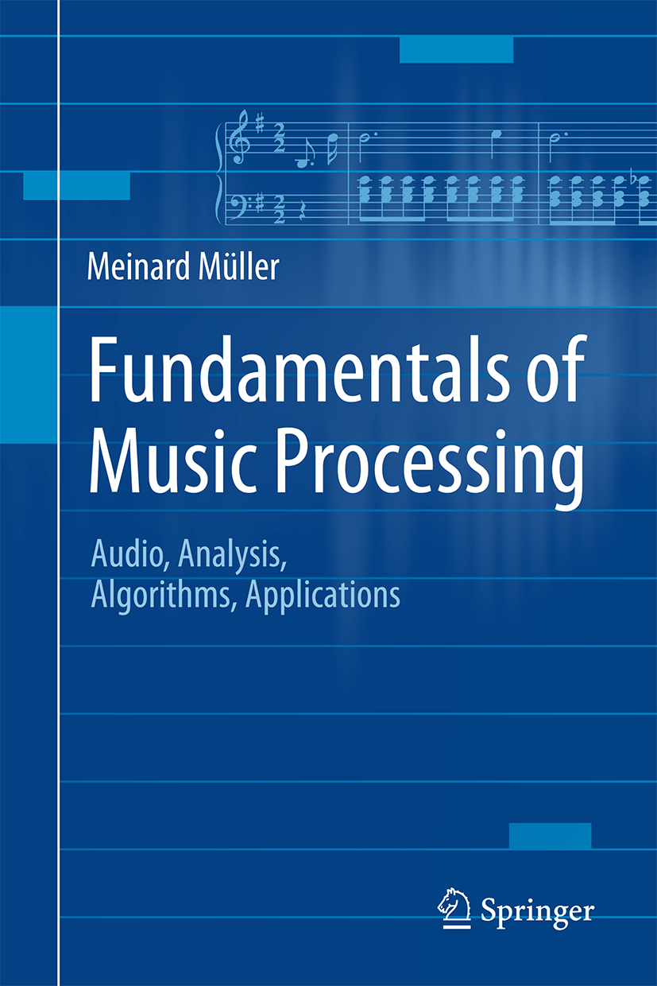

Book: Fundamentals of Music Processing
Meinard Müller
Fundamentals of Music Processing
Audio, Analysis, Algorithms, Applications
483 p., 249 illus., 30 illus. in color, hardcover
ISBN: 978-3-319-21944-8
Springer, 2015
Accompanying website:
www.music-processing.de

Slide 3
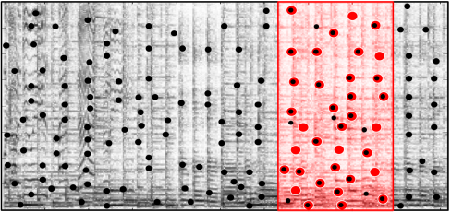
Chapter 7: Content-Based Audio Retrieval
7.1 Audio Identification
7.2 Audio Matching
7.3 Version Identification
7.4 Further Notes
One important topic in information retrieval is concerned with the development of search engines that enable users to explore music collections in a flexible and intuitive way. In Chapter 7, we discuss audio retrieval strategies that follow the query-by-example paradigm: given an audio query, the task is to retrieve all documents that are somehow similar or related to the query. Starting with audio identification, a technique used in many commercial applications such as Shazam, we study various retrieval strategies to handle different degrees of similarity. Furthermore, considering efficiency issues, we discuss fundamental indexing techniques based on inverted lists—a concept originally used in text retrieval.

Slide 4
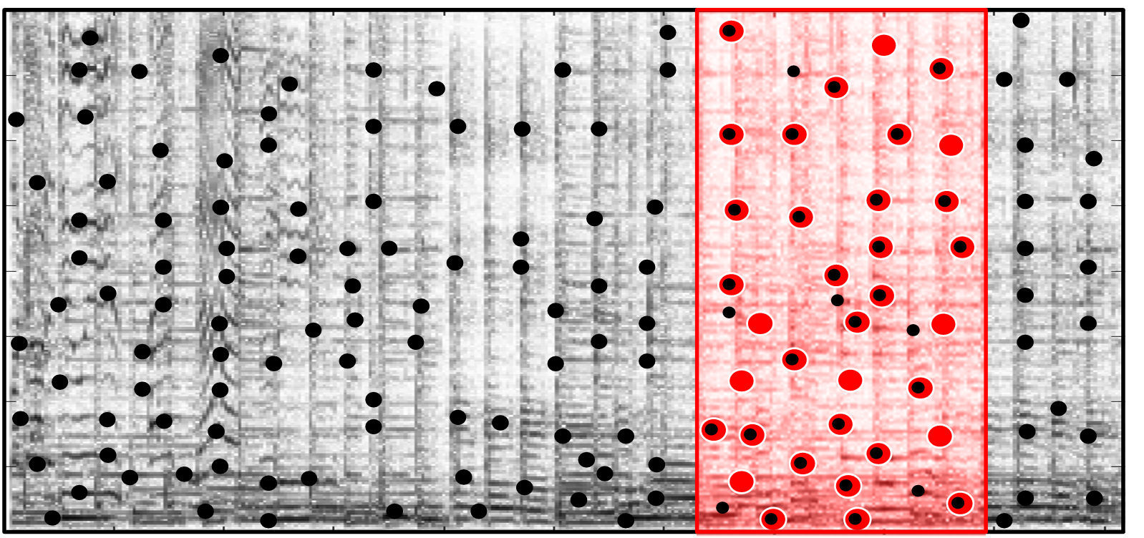
7 Content-Based Audio Retrieval
Teaser

Slide 5
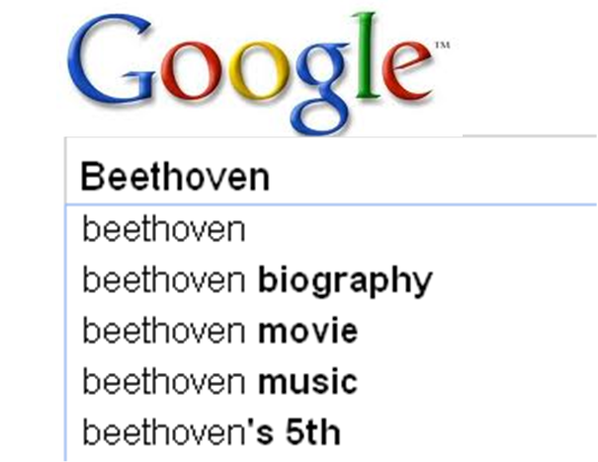
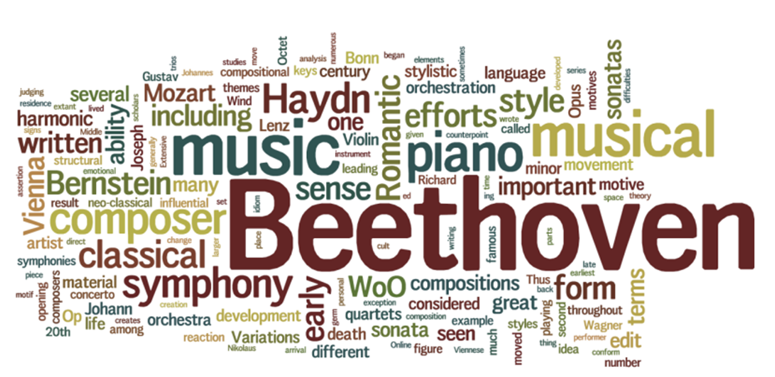
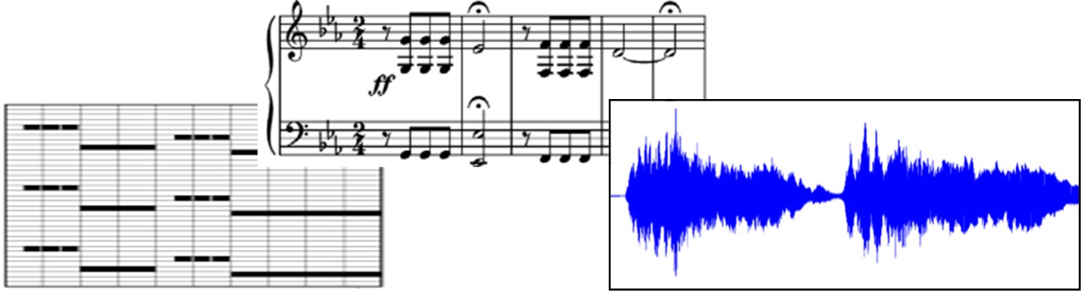
7 Content-Based Audio Retrieval
Fig. 7.1

Slide 6
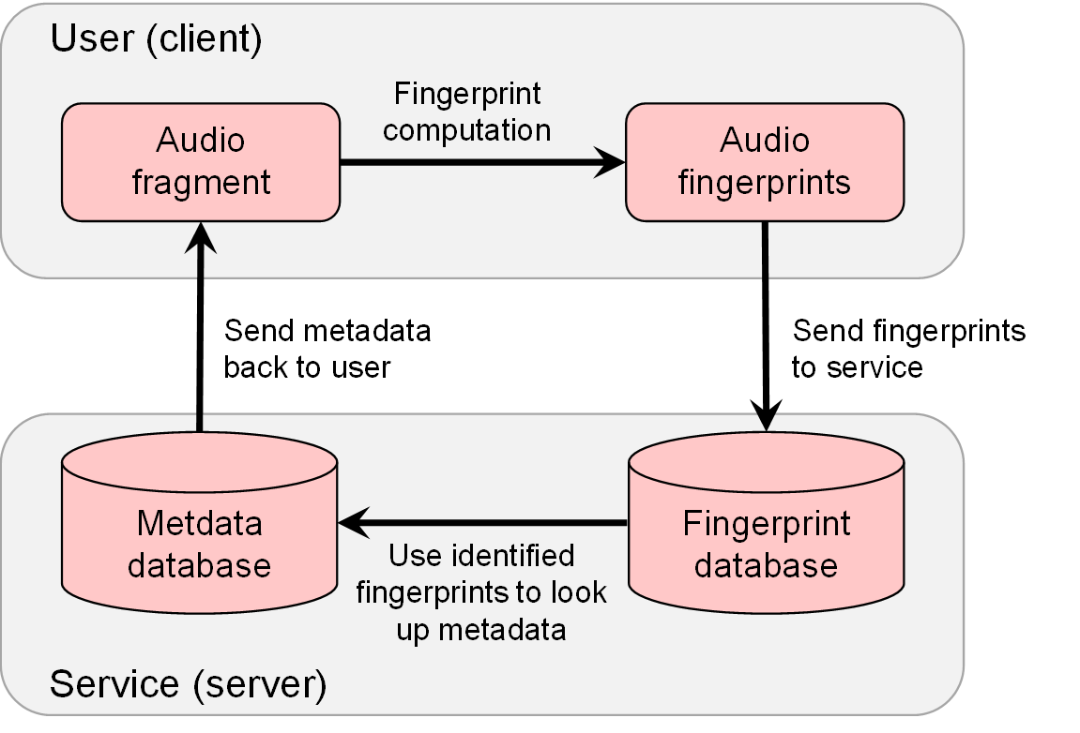
7.1 Audio Identification
Fig. 7.2

Slide 7
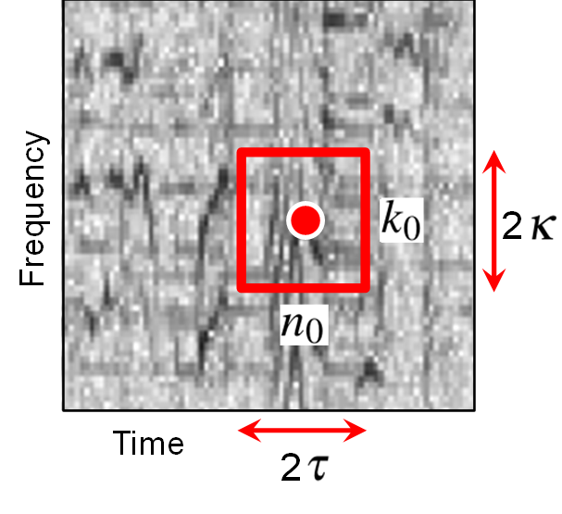
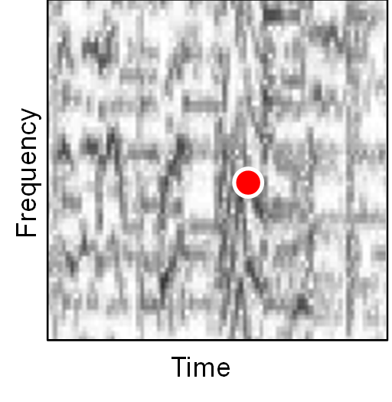
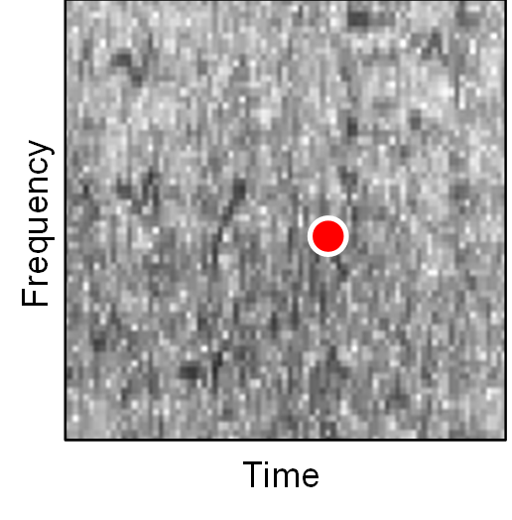
7.1 Audio Identification
Fig. 7.3

Slide 8
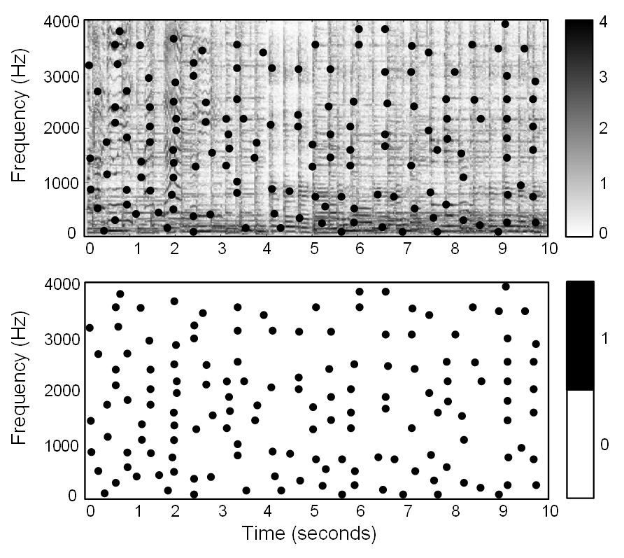
7.1 Audio Identification
Fig. 7.4

Slide 9
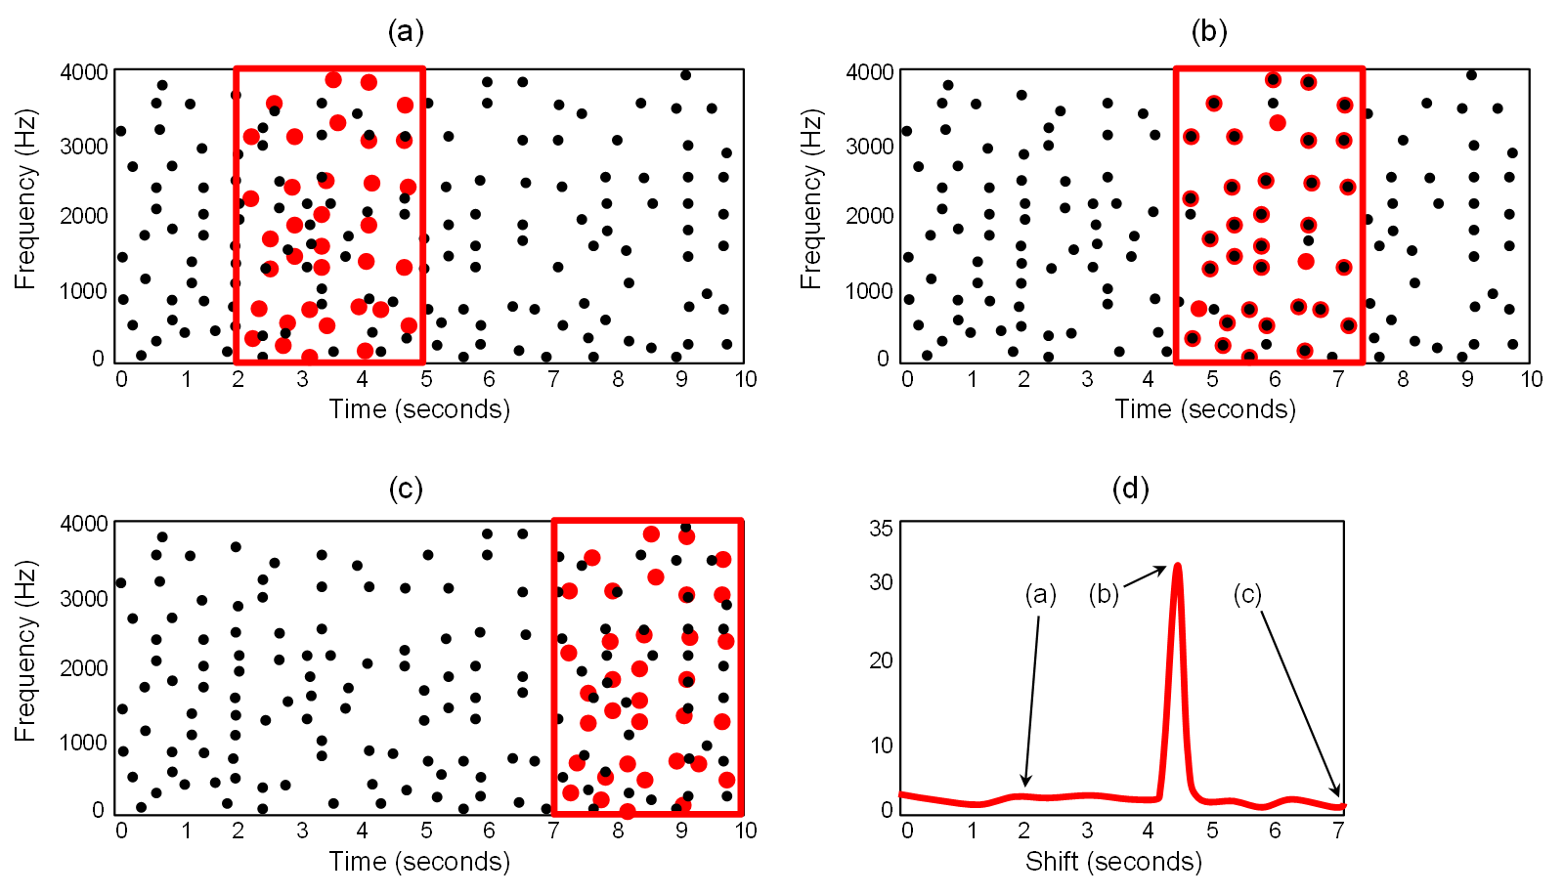
7.1 Audio Identification
Fig. 7.5

Slide 10
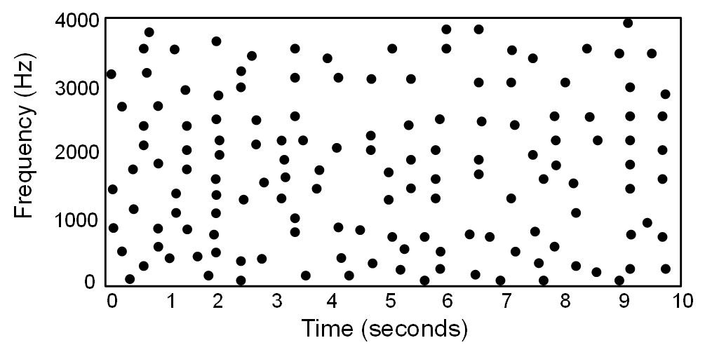
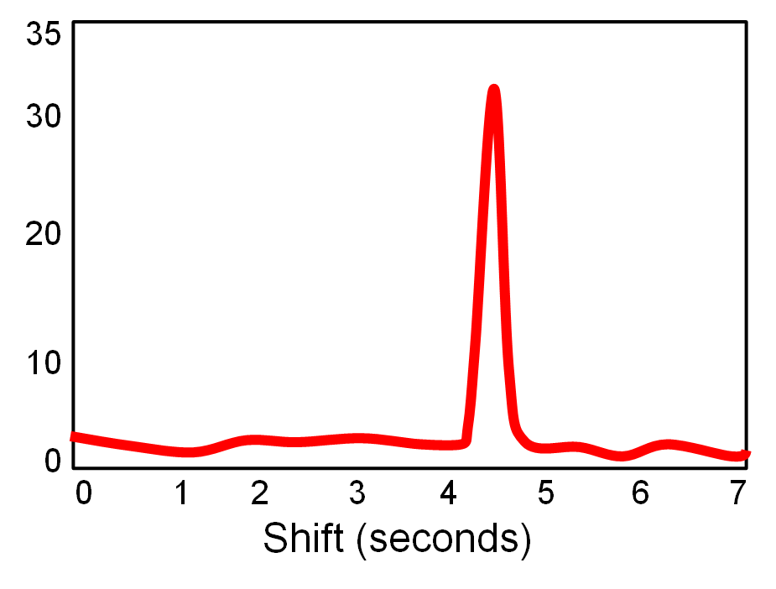
7.1 Audio Identification
Fig. 7.5

Slide 11
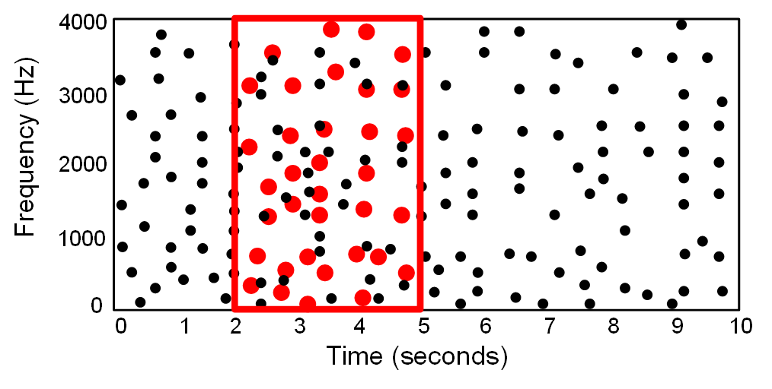
7.1 Audio Identification
Fig. 7.5

Slide 12
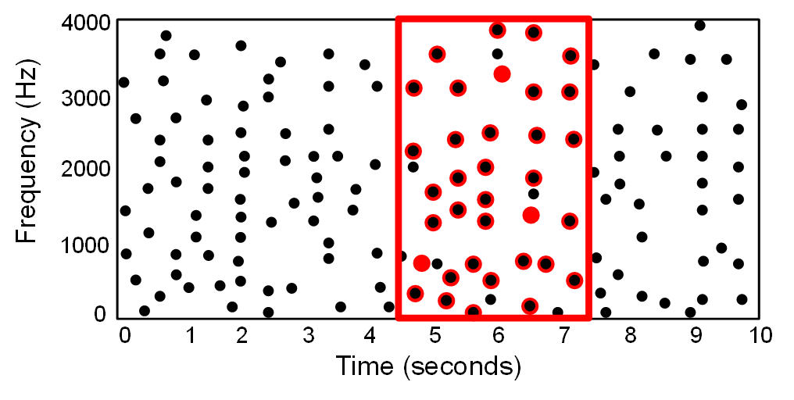
7.1 Audio Identification
Fig. 7.5

Slide 13
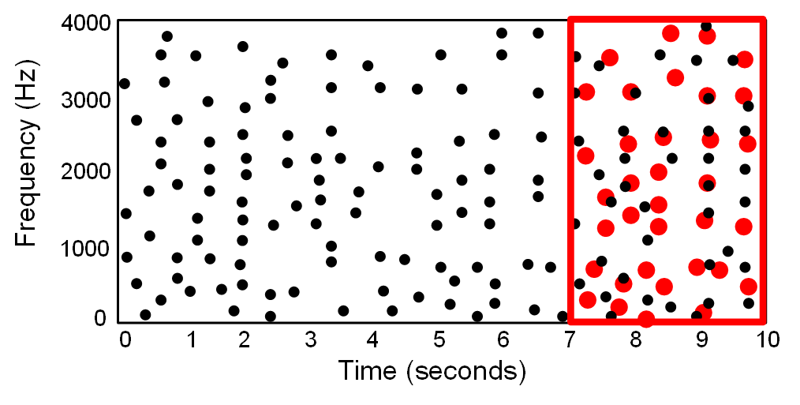
7.1 Audio Identification
Fig. 7.5

Slide 14
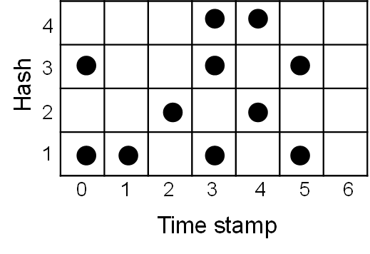
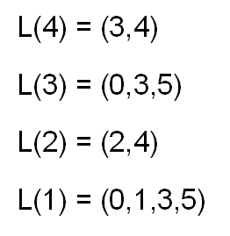
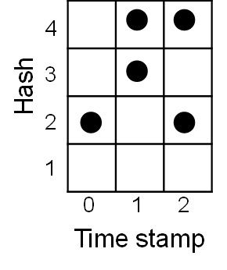
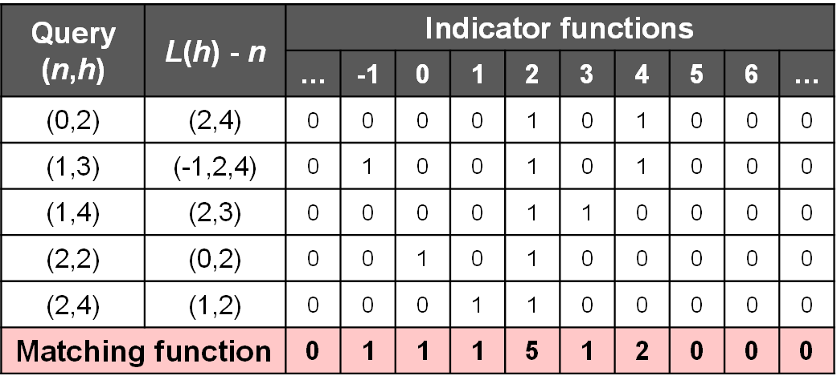
7.1 Audio Identification
Fig. 7.6

Slide 15
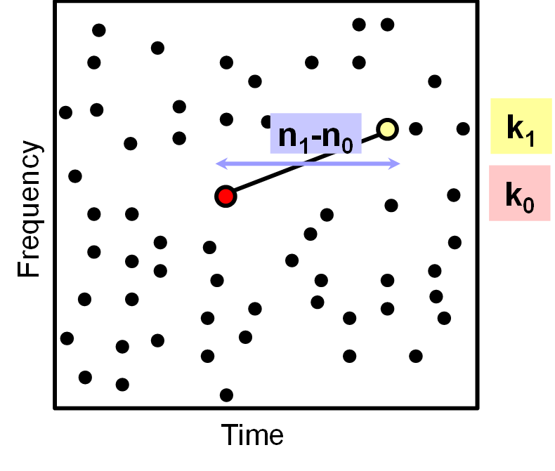
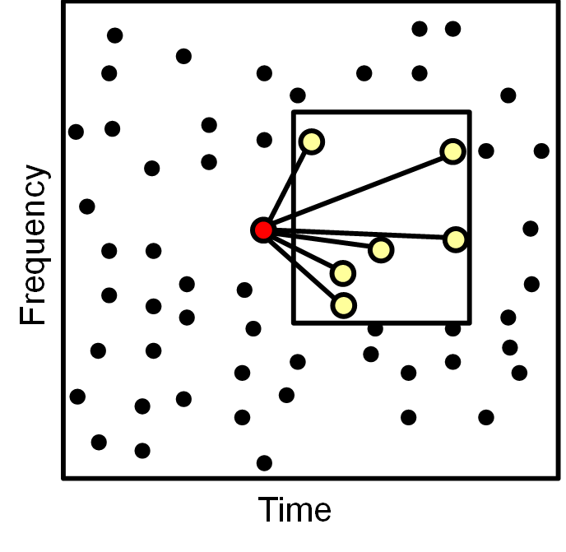
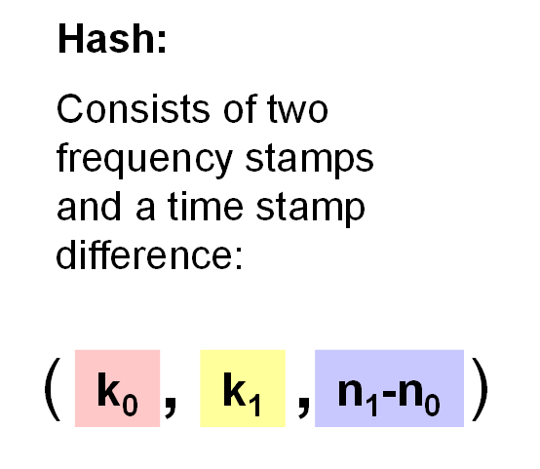
7.1 Audio Identification
Fig. 7.7

Slide 16
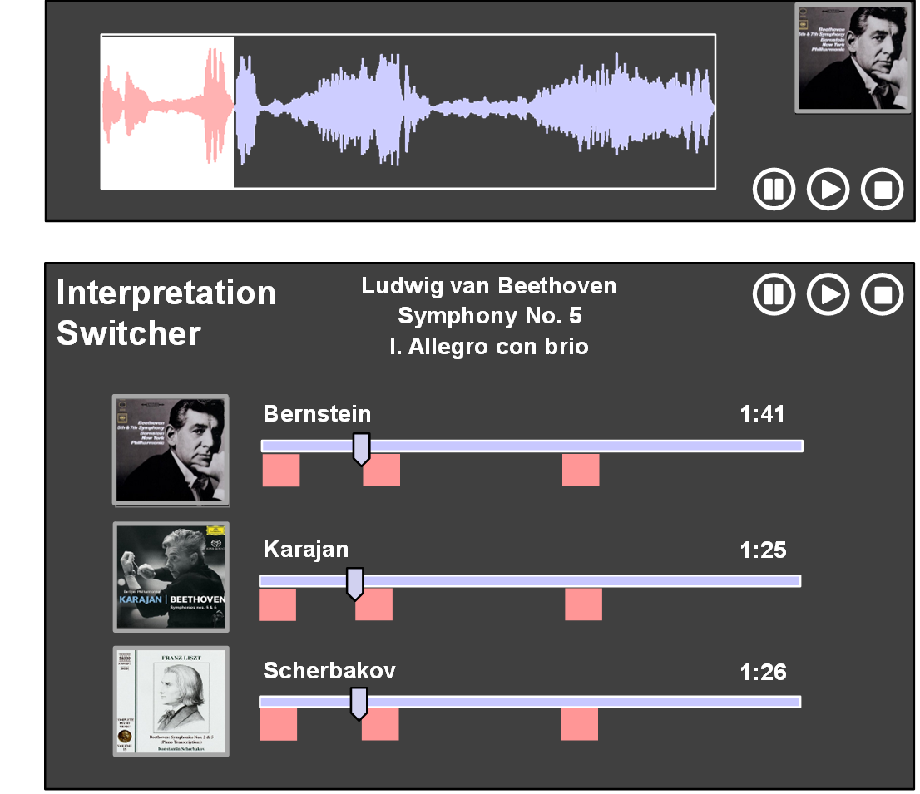
7.2 Audio Matching
Fig. 7.8

Slide 17
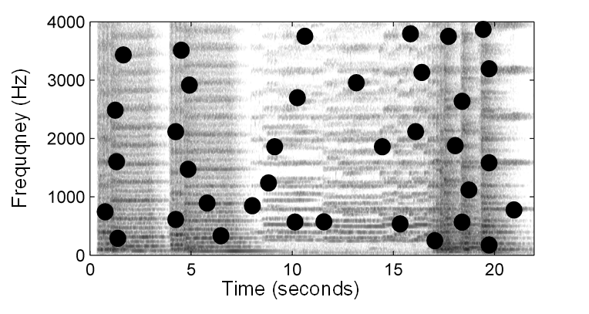
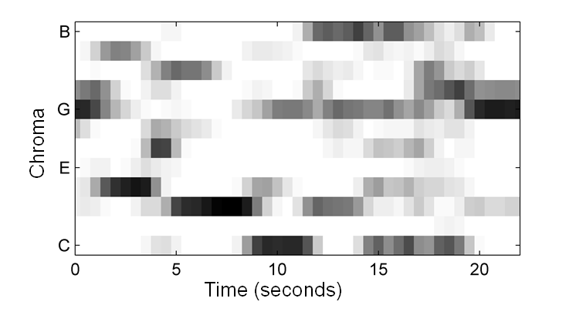
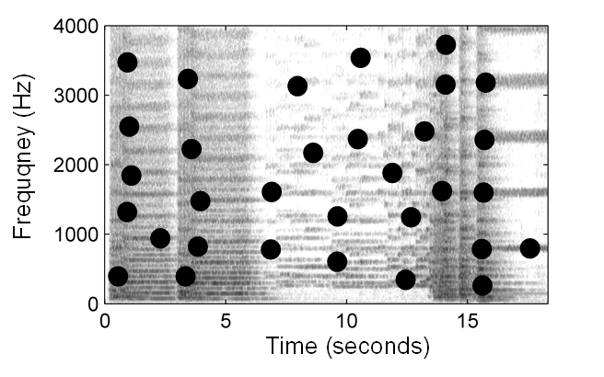
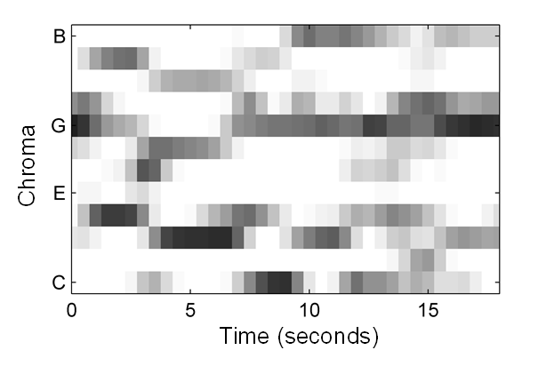
7.2 Audio Matching
Fig. 7.9

Slide 18
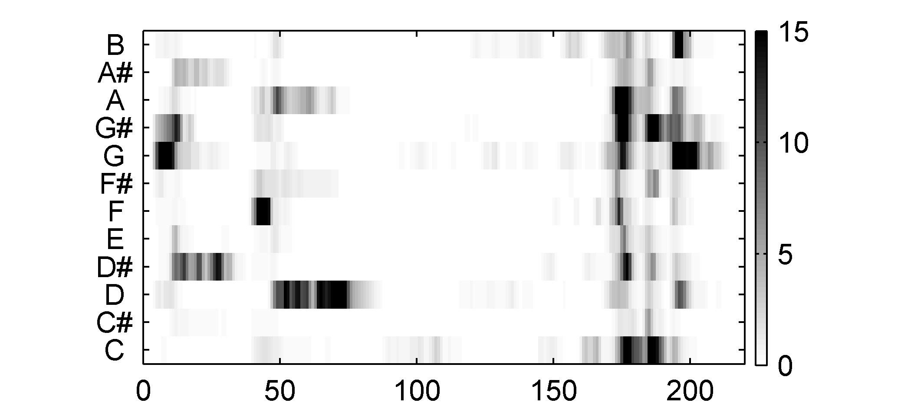
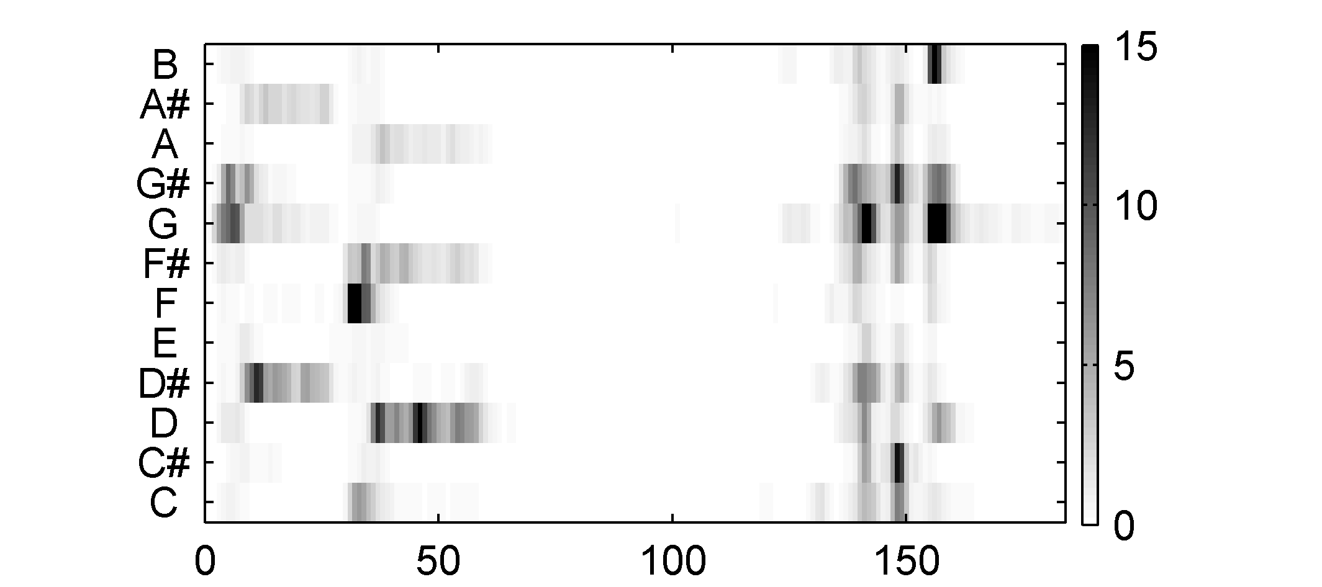
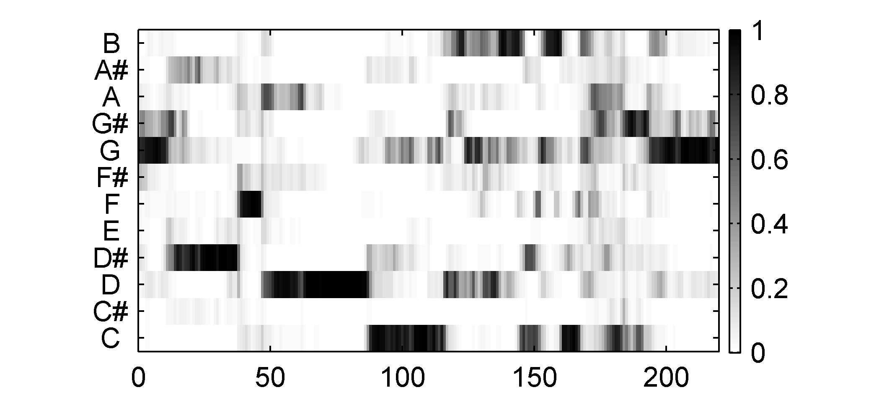
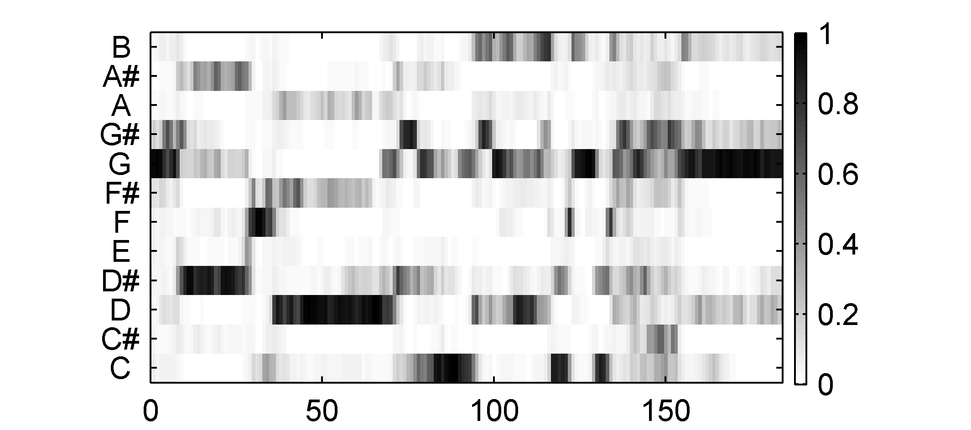
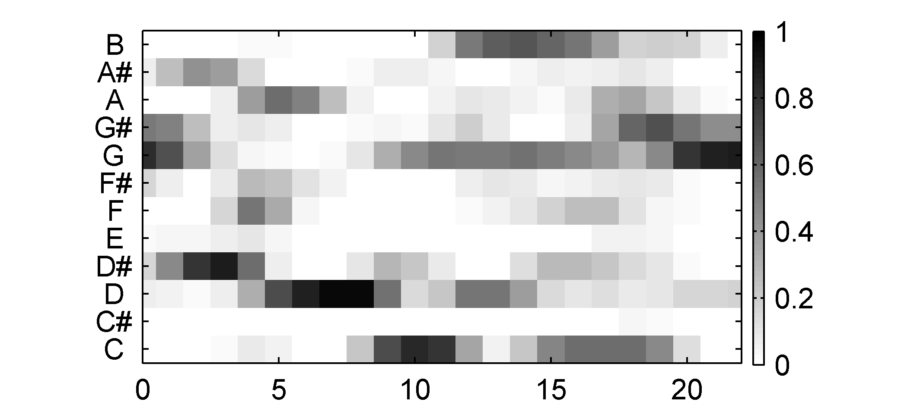
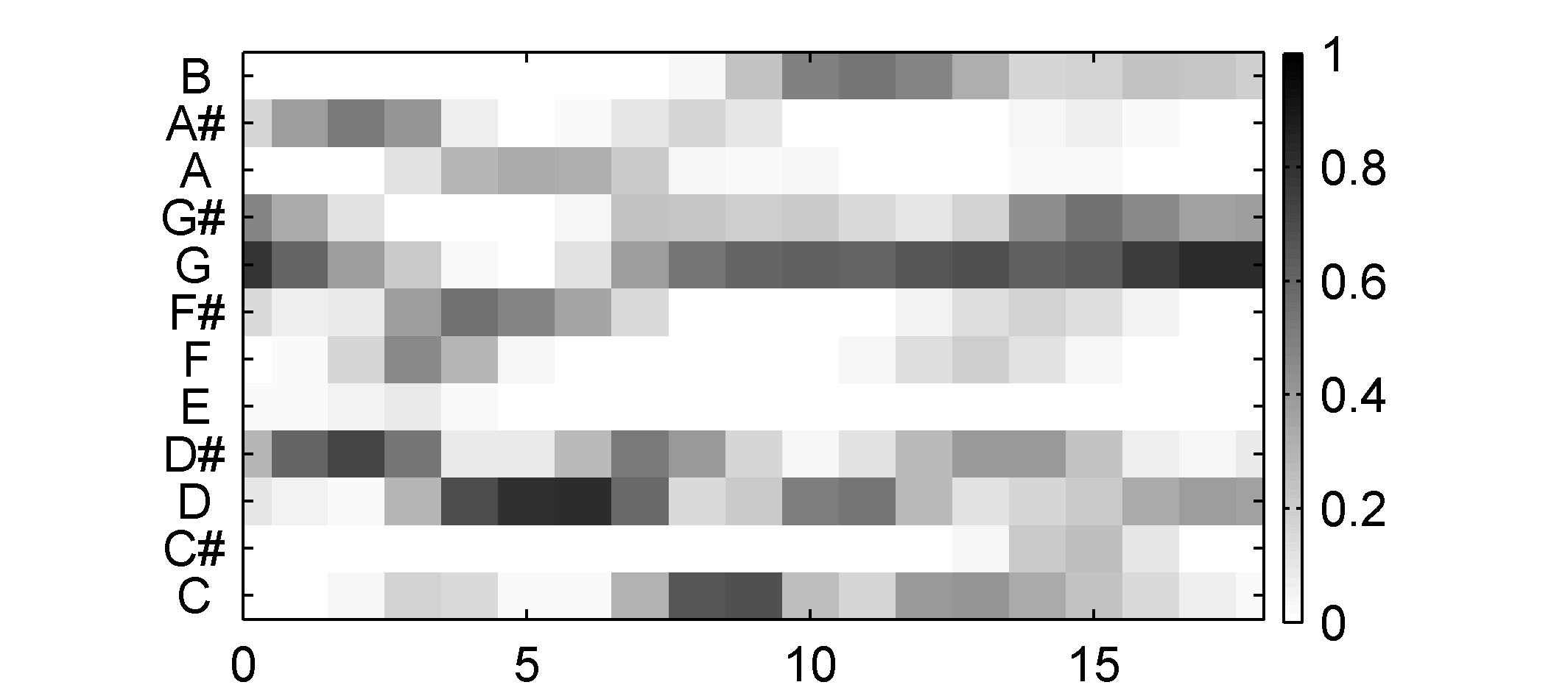
7.2 Audio Matching
Fig. 7.10
Time (samples)
Time (samples)
Time (samples)
Time (samples)
Time (samples)
Time (samples)

Slide 19
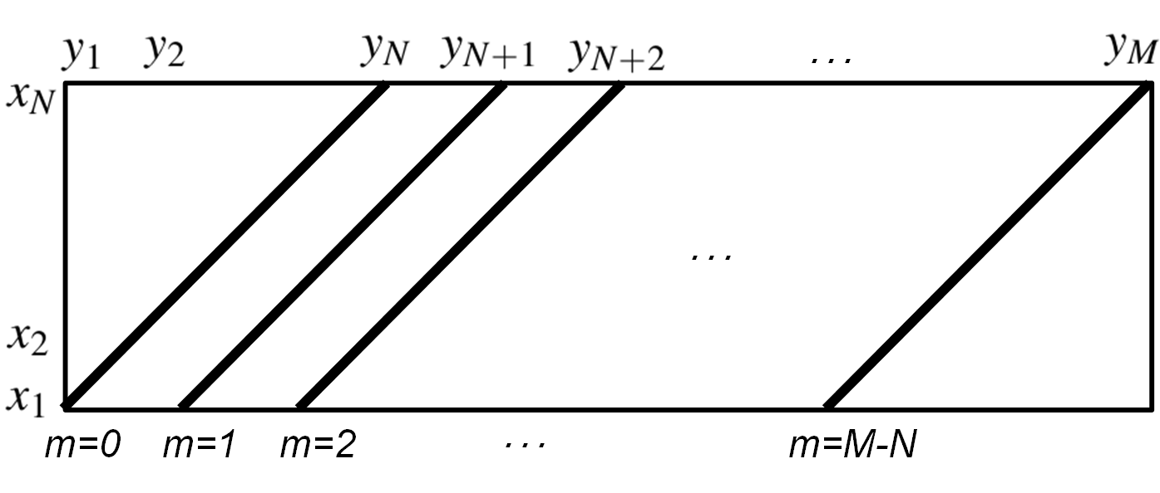
7.2 Audio Matching
Fig. 7.11

Slide 20
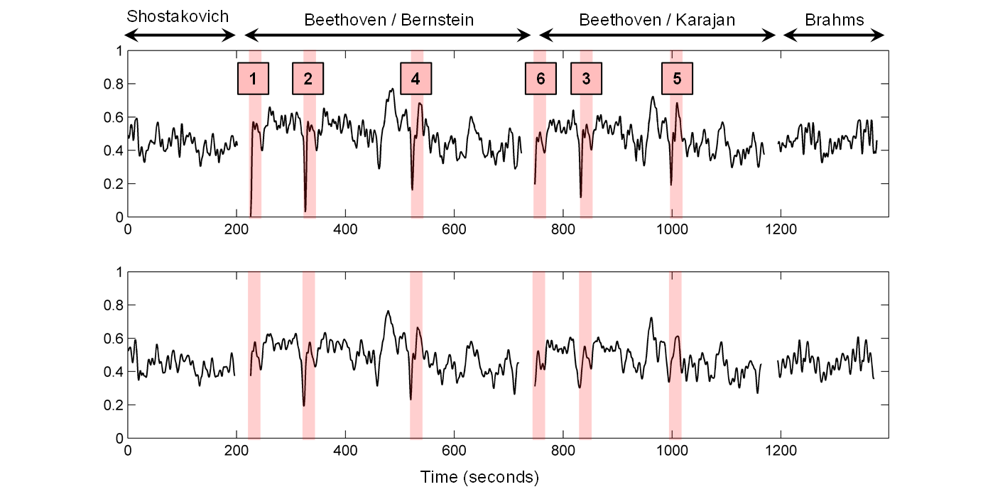
7.2 Audio Matching
Fig. 7.12

Slide 21
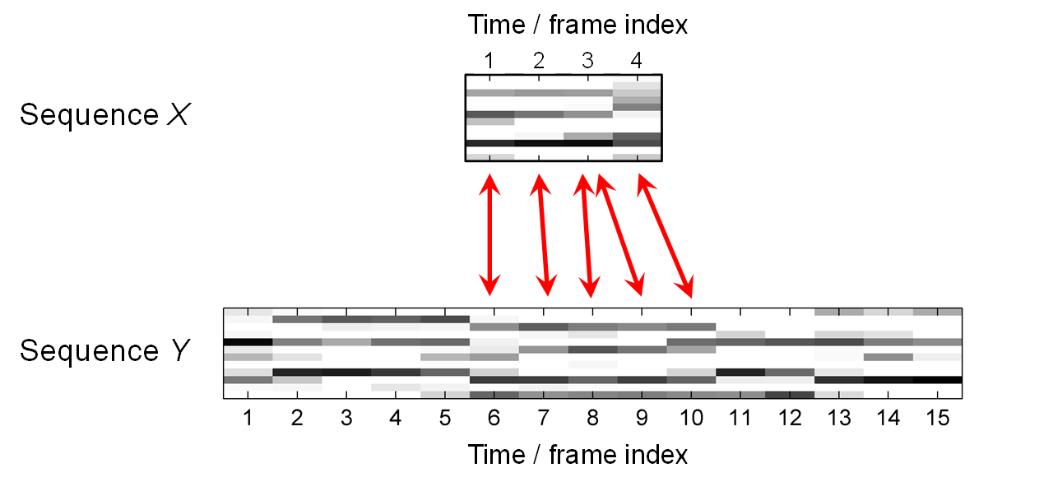
7.2 Audio Matching
Fig. 7.13

Slide 22
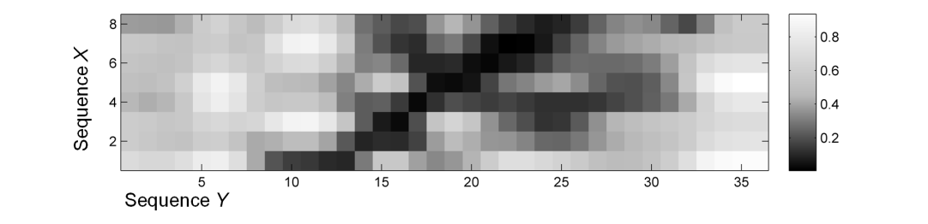
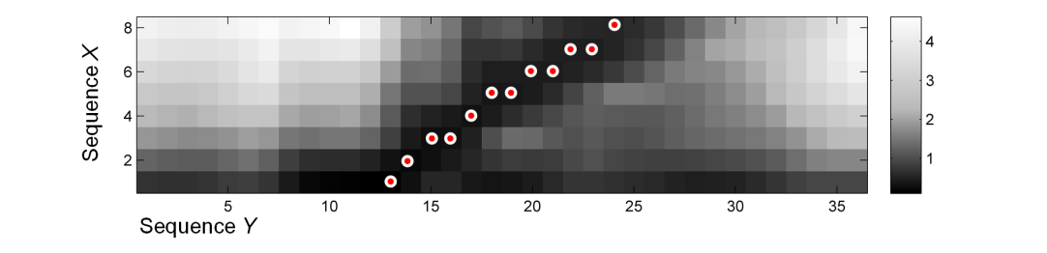
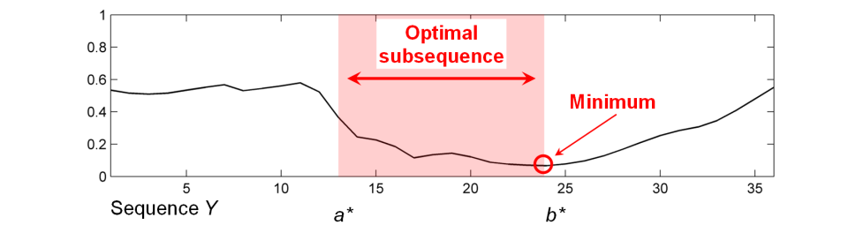
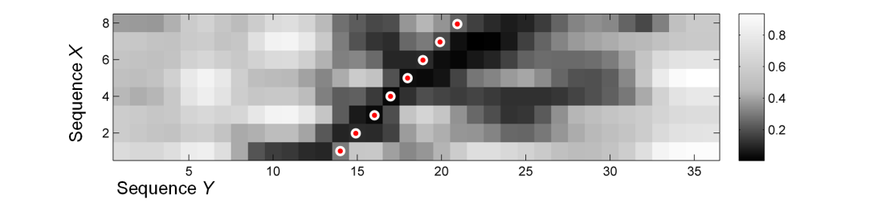
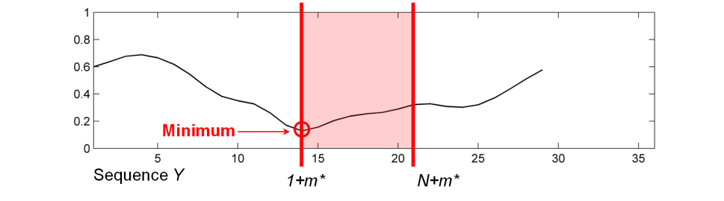
7.2 Audio Matching
Fig. 7.14

Slide 23
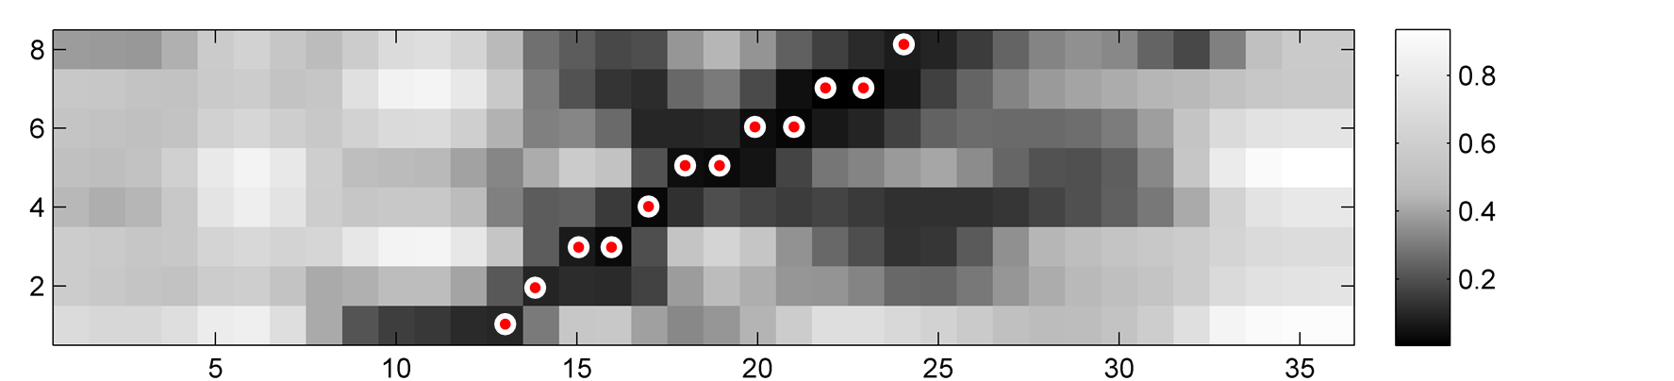

7.2 Audio Matching
Fig. 7.14
Sequence X
Sequence Y

Slide 24
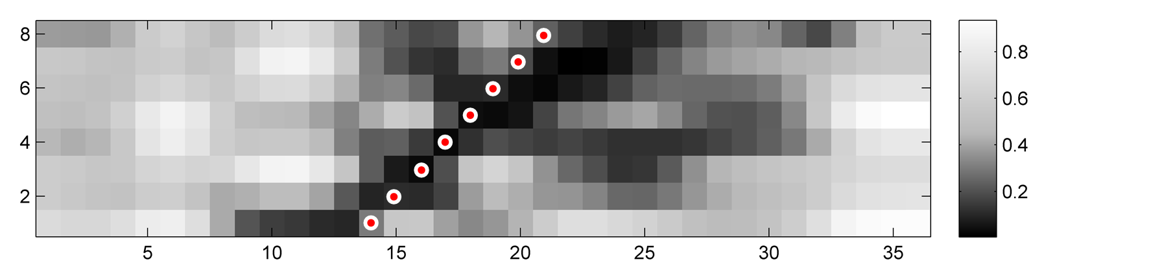

7.2 Audio Matching
Fig. 7.14
Sequence X
Sequence Y

Slide 25
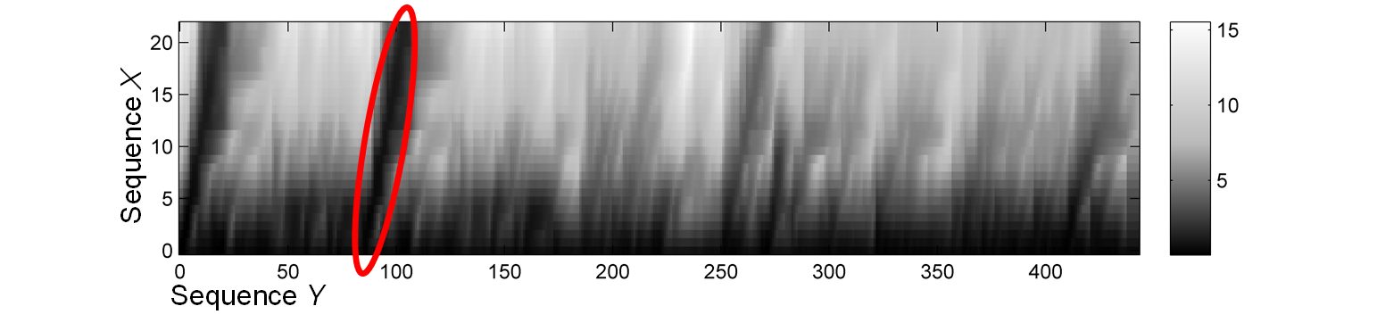
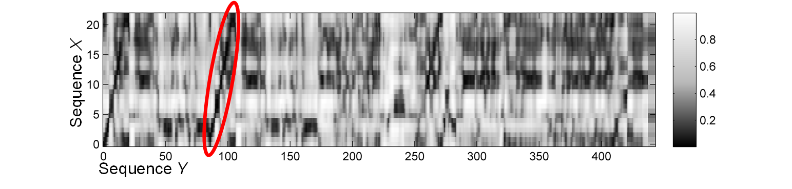
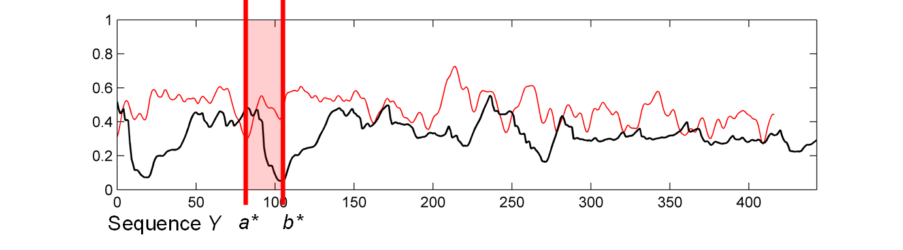
7.2 Audio Matching
Fig. 7.15

Slide 26
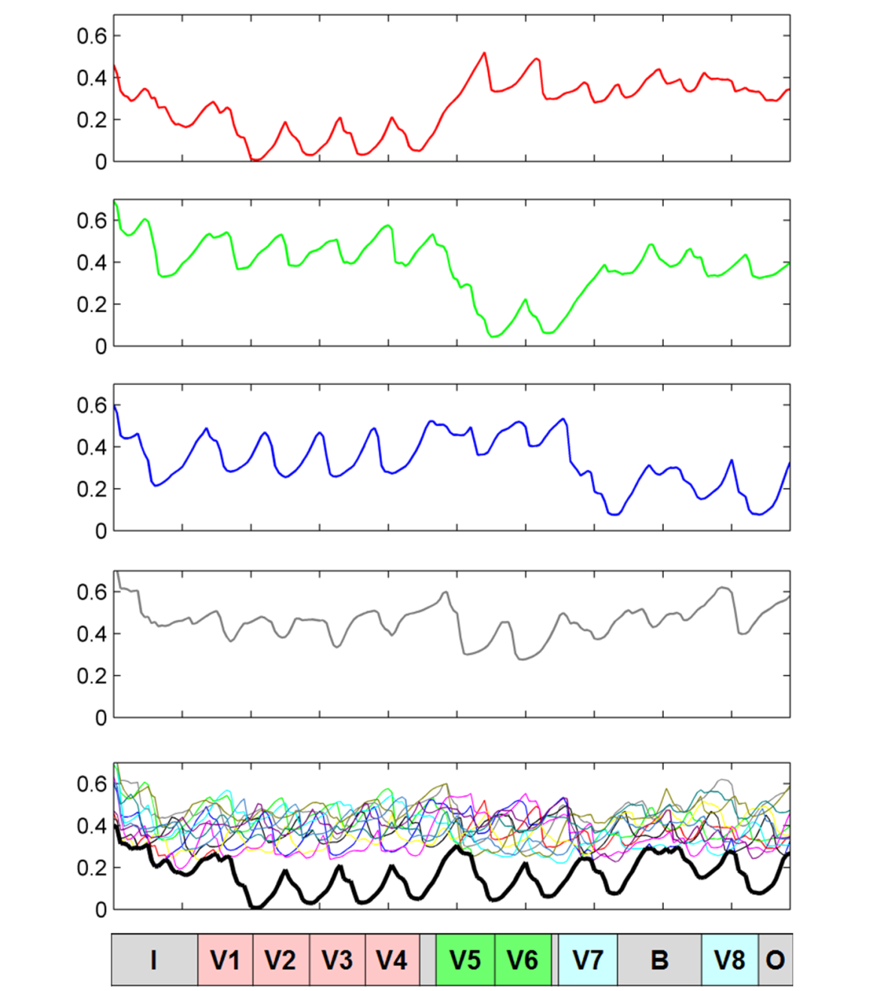
7.2 Audio Matching
Fig. 7.16

Slide 27
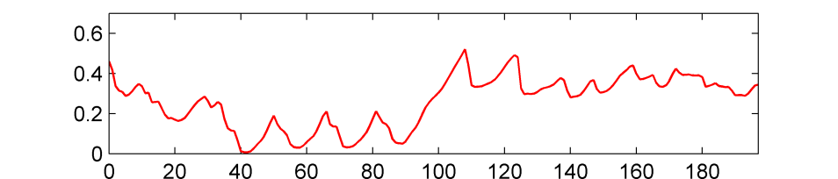
7.2 Audio Matching
Fig. 7.16

Slide 28

7.2 Audio Matching
Fig. 7.16

Slide 29

7.2 Audio Matching
Fig. 7.16

Slide 30

7.2 Audio Matching
Fig. 7.16

Slide 31

7.2 Audio Matching
Fig. 7.16

Slide 32

7.3 Version Identification
Fig. 7.17

Slide 33

7.3 Version Identification
Fig. 7.18

Slide 34

7.3 Version Identification
Fig. 7.19
Time (seconds)
Time (seconds)

Slide 35

7.3 Version Identification
Fig. 7.19
Time (seconds)
Time (seconds)

Slide 36

7.3 Version Identification
Fig. 7.19
Time (seconds)
Time (seconds)

Slide 37



7.3 Version Identification
Fig. 7.20

Slide 38



7.3 Version Identification
Fig. 7.21

Slide 39

7.4 Further Notes
Fig. 7.22

Slide 40

7.4 Further Notes
Table 7.1

Slide 41

7.4 Further Notes
Fig. 7.23

Slide 42

7.4 Further Notes
Fig. 7.23

Slide 43

7.4 Further Notes
Fig. 7.23

Slide 44

7.4 Further Notes
Fig. 7.23

